Slide 1


Better, Broader, Safer: Using Health Data for Research and Analysis
Jess Morley
@jessRmorley

Slide 2
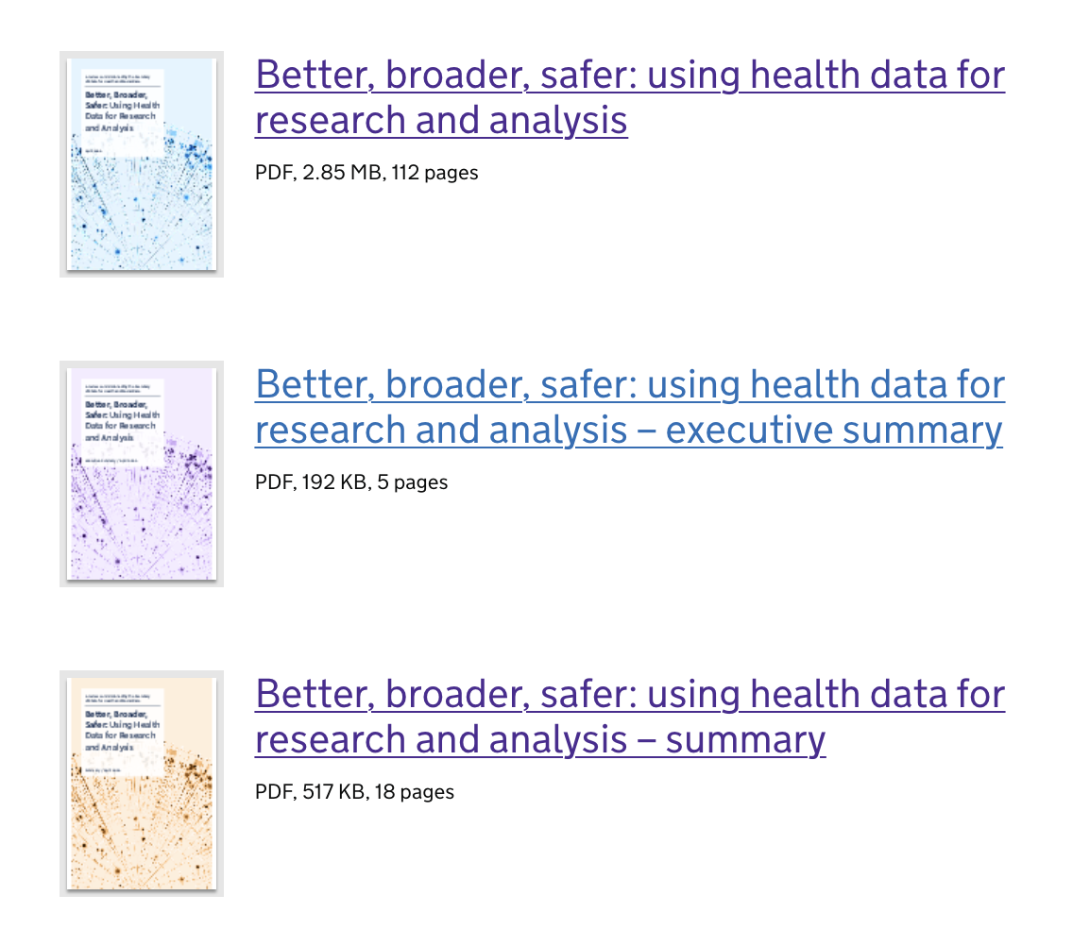
Background
Broad terms of reference
300+ Interviews
Desk Research
Focus Groups
>180 Recommendations

Slide 3
Platforms and security
1.Build trust by taking concrete action on privacy and transparency: trust cannot be earned through communications and public engagement alone.
2. Ensure all NHS data policies actively acknowledge the shortcomings of ‘pseudonymisation’ and ‘trust’ as techniques to manage patient privacy:
3. Build a small number of secure analytics platforms – shared ‘Trusted Research Environments’ – then make these the norm
4. Use the enhanced privacy protections of TREs to create new, faster access rules and processes for safe users of NHS data; ensure all TREs publish logs of all activity, to build public trust.
5. Map all current bulk flows of pseudonymised NHS GP data, and then shut these down, wherever possible, as soon as TREs for GP data meet all reasonable user needs.
6. Use TREs – where all analysts work in a standard environment – as a strategic opportunity to drive modern, efficient, open, collaborative approaches to data science.

Slide 4
Modern, Open Working Methods for NHS Data
7. Promote and resource ‘Reproducible Analytical Pathways’ as the minimum standard for academic and NHS data analysis
8. Ensure all code for data curation and analysis paid for by the state through academic funders and NHS procurement is shared openly, with appropriate technical documentation, to all data users.
9. Recognise software development as a central feature of all good work with data.
10. Bridge the gap between health research and software development: train academic researchers and NHS analysts in contemporary computational data science techniques, using RAP where appropriate; offer ‘onboarding’ training for software developers and data scientists who are entering health services research and epidemiology; use in-person and online training; make online resources openly available where possible.
11. Note that ‘open code’ is different to ‘open data’: it is reasonable for the NHS and government to do some analyses discreetly without sharing all results in real time.
Notes:
https://openprescribing.net/measure/statinintensity/national/england/#statinintensity

Slide 5
Data curation and knowledge management
12. Stop doing data curation differently, to variable and unseen standards, duplicatively in every team, data centre, and project: recognise NHS data curation as a complex, standalone, high status technical challenge of its own.
13. Meet this challenge with systematic curation work, devoted teams, shared working practices, shared code, shared tools, and shared documentation; driven by open competitive funding to develop new shared curation methods and tools, and to manually curate data for individual datasets and fields.
14. Use TREs as an opportunity to impose standards on how commonly used datasets are stored, and curated into analysis-ready tables.
15. Create an open online library for NHS data curation code, validity tests, and technical documentation with dedicated staff who have appropriate skills in data science, curation, and technical documentation; so that new analysts, academics and innovators can arrive to find platforms with well curated data and accessible technical documentation.
Notes:
https://openprescribing.net/measure/statinintensity/

Slide 6
NHS Data Analysts
16. Create an NHS Analyst Service modelled on the Government Economic Service and Statistical Service
17. Embrace modern, open working methods for NHS data analysis by committing to Reproducible Analytical Pipelines (RAP) as the core working practice that must be supported by all platforms and teams; make this a core focus of NHS analyst training.
18. Create an Open College for NHS Analysts
19. Recognise the value of knowledge management: create and maintain a curated national open library of NHS analyst code and methods, with adequate technical documentation
20. Seek expert help from academia and industry, but ensure all code and technical documentation is openly available to all, procuring newly created ‘intellectual property’ on a ‘buy out’ basis
21. Train senior non-analysts and leaders in how to be good customers of data teams.
Notes:
https://bjgp.org/content/70/697/e525

Slide 7
Governance
22. Rationalise approvals
23. Have a frank public conversation about commercial use of NHS data for innovation, but only after privacy issues have been addressed through adoption of TREs; ensure the NHS gets appropriate financial return where marketable innovations are driven by NHS data, which has been collected at great cost over many decades; avoid exclusive commercial arrangements.
24. Develop clear rules around the use of NHS patient records in performance management of NHS organisations, aiming to: ensure reasonable use in improving services; avoid distracting NHS organisations with unhelpful performance measures.
25. Address the problem of 160 trusts and 6,500 GPs all acting as separate data controllers.
Notes:
https://openprescribing.net/measure/ktt9_cephalosporins/national/england/

Slide 8
Approaches and Strategy
26. Use people with technical skills to manage complex technical problems – create very senior strategic leadership roles for developers, data architects and data scientists; offer leadership training to those in existing technical roles. (Also train senior leaders in the basics of data analysis, software development, and clinical informatics; but recognise the limitations of that approach).
27. Build impatiently, but incrementally, accepting that new ways of working are overdue, but cannot replace old methods overnight. We must build skills, and prove the value of modern approaches to data in parallel to maintaining old services and teams.
28. Identify a range of ‘data pioneer’ groups from each key sector: 3 ICS analyst teams; 3 national quality improvement registry or audit teams; 3 academic birth cohort or electronic health record analysis teams; and 1 to 3 national NHS analytic teams. These should be selected competitively as those with the best current technical skills
29. Build TRE capacity by taking a hands-on approach to the components of work common to all TREs. Avoid commissioning multiple closed, black box data projects from which little can be learned, or framing these as ‘experiments’. Experimentation is only powerful where it delivers openly shared working methods, code, outputs and technical documentation from which all can learn.
30. Focus on platforms by resourcing teams, services and institutions who are focused solely on facilitating great analytic work by other people, working closely with users. Data curation, secure analytics, TREs, libraries, RAP training, and platforms are the key missing link: they will only be delivered if they become high status, independent activities.
Notes:
https://openprescribing.net/measure/statinintensity/

Slide 9
The NHS Data Strategy
Commits to the following:
Implementing secure data environments (TREs) as the default across the NHS
Simplifying the Information Governance Framework; creating fit-for-purpose rules around different types of data - including pseudonymised data; simplifying the national data opt-out; standardising approaches to PPIE; and tackling the ‘bigger’ issues through participatory engagement such as citizens juries
Insisting that “Public services are built with public money, and so the code they are based on should be made available across the health and care system, and those working with it, to reuse and build on.”
Notes:
https://openprescribing.net/measure/statinintensity/

Slide 10
Conclusions
The NHS has a phenomenal resource in the detailed data that has been collected for tens of millions of patients, over the course of many decades. This data represents a spectacular opportunity to improve NHS care, and drive innovation in the life sciences sector.
We should all regard it as a profound ethical duty to make the best use of this resource.
By investing in a coherent approach to data curation, and a small number of secure platforms, the nation can unlock all the untapped potential in NHS data.
This will reap rewards across the global research community. It will drive innovation across the whole life sciences sector. And it will drive change across the NHS.
In all this, we must earn public trust. If we can show the public that we have built secure platforms for data sharing, then every patient can confidently embrace sharing their records, safely and securely, for the good of the NHS, and humanity, around the globe.
COVID-19 has brought fresh urgency, and shone a harsh light on some current shortcomings. But future pandemics and waves may bring bigger challenges; and there were always lives waiting to be saved through better, broader, faster, safer use of NHS data.
Notes:
https://openprescribing.net/measure/statinintensity/

Slide 11



Get in touch!
www.bennett.ox.ac.uk
jessica.morley@phc.ox.ac.uk
@BennettOxford
@jessRMorley
@bengoldacre

